Slide 1
What is a Computer?
Computer
Device capable of performing computations and making logical decisions (hardware)
Computers process data under the control of sets of instructions called computer programs (software)
Hardware
Various devices comprising a computer, such as central processing unit (CPU), memory, motherboard and hard disks as well as peripheral devices (keyboard, screen, mouse CD-ROM)
Hardware trends − Every year or two the following approximately double:
Amount of memory in which to execute programs
The processor speed at which computers execute their programs
Software
Programs that run on a computer

Slide 2
Computer Organization
Six logical units in every computer:
Input unit
Obtains information from input devices (keyboard, mouse)
Output unit
Outputs information (to screen, to printer, to control other devices)
Memory unit
Rapid access, low capacity, stores input information
Arithmetic and logic unit (ALU)
Performs arithmetic calculations and logic decisions
Central processing unit (CPU)
Supervises and coordinates the other sections of the computer
ALU is now a fundamental building block of the CPU
Secondary storage unit
Cheap, long-term, high-capacity storage
Stores inactive programs

Slide 3
Evolution of Operating Systems
Batch processing
Do only one job or task at a time
Operating systems
Manage transitions between jobs
Increased throughput
Amount of work computers process
Multiprogramming
Computer resources are shared by many jobs or tasks
Timesharing
Computer runs a small portion of one user’s job then moves on to service the next user

Slide 4
Personal Computing, Distributed Computing, and Client/Server Computing
Personal computers
Economical enough for individual
Distributed computing
Computing distributed over networks
Client/server computing
Sharing of information across computer networks between file servers and clients (personal computers)

Slide 5
Machine Languages, Assembly Languages, and High-level Languages
Three types of programming languages
Machine languages
Strings of numbers giving machine specific instructions
Example: +1300042774
Assembly languages
English-like abbreviations representing elementary computer operations (translated via assemblers)
Example: LOAD BASEPAY
High-level languages
Codes similar to everyday English
Use mathematical notations (translated via compilers)
Example: grossPay = basePay + overTimePay

Slide 6
Fortran, COBOL, Pascal and Ada
FORTRAN
Developed by IBM Corporation in the 1950s
Used for scientific and engineering applications that require complex mathematical computations
COBOL
Developed in 1959 by computer manufacturers, the government and industrial computer users
Used for commercial applications that require precise and efficient manipulation of large amounts of data Pascal
Pascal
Developed by Professor Niklaus Wirth in 1971
Designed for teaching structured programming
Ada
Developed under the sponsorship of the U.S. Department of Defense (DOD) during the 1970s and early 1980s
Able to perform multitasking

Slide 7
History of C
C
Evolved by Ritchie from two previous programming languages, BCPL and B
Used to develop UNIX
Used to write modern operating systems
Hardware independent (portable)
By late 1970's C had evolved to “Traditional C”
Standardization
Many slight variations of C existed, and were incompatible
Committee formed to create a "unambiguous, machine-independent" definition
Standard created in 1989, updated in 1999

Slide 8
C Standard Library
C programs consist of pieces/modules called functions
A programmer can create his own functions
Advantage: the programmer knows exactly how it works
Disadvantage: time consuming
Programmers will often use the C library functions
Use these as building blocks
Avoid re-inventing the wheel
If a premade function exists, generally best to use it rather than write your own
Library functions carefully written, efficient, and portable

Slide 9
C++
C++
Superset of C developed by Bjarne Stroustrup at Bell Labs
"Spruces up" C, and provides object-oriented capabilities
Object-oriented design very powerful
10 to 100 fold increase in productivity
Dominant language in industry and academia
Learning C++
Because C++ includes C, some feel it is best to master C, then learn C++

Slide 10
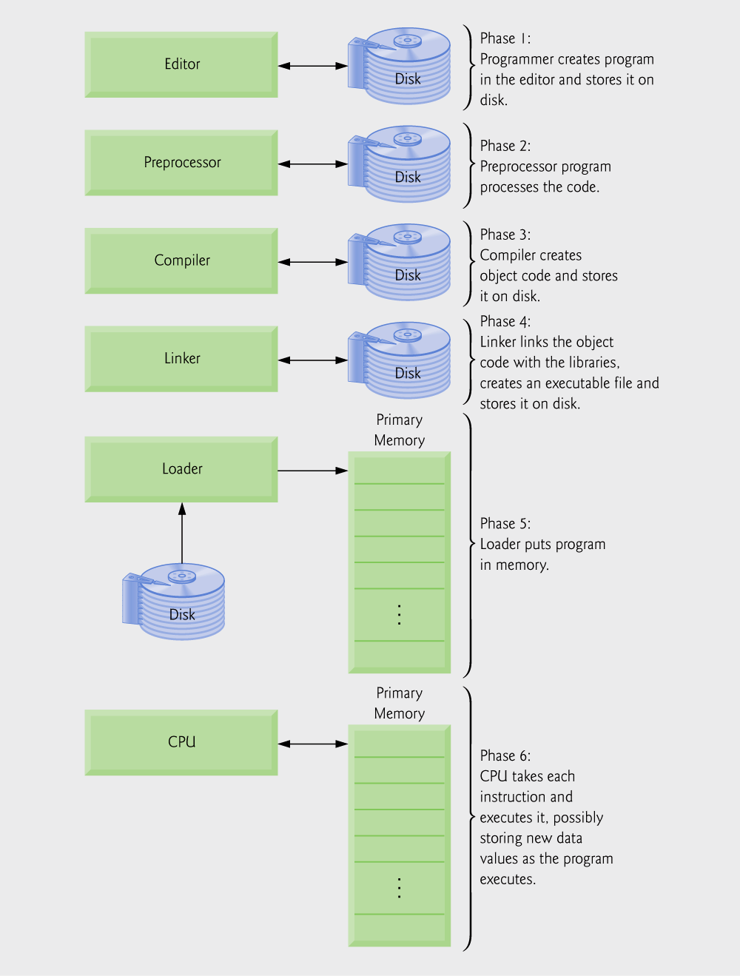
A Typical C Program Development Environment
Phases of C Programs:
Edit (C program file names should end with the .c extension)
Preprocess
Compile
Link
Load
Execute

Slide 11
A Typical C Program Development Environment
Phase 1: Create your program with an editor program
Phase 2: A preprocessor find some preprocessor directives (#include <stdio.h>) to include other files and perform various text replacements
Phase 3: Compiler compiles the program into machine languages (object code != object-oriented programming).
Phase 4: A linker links the object code with the code in library or other places to produce an executable image.
Phase 5: A loader loads the executable image into memory (RAM).
Phase 6: CPU executes the program one instruction at a time. The load process in Windows OS is just input the name of the executable file (for example, lab01.exe).

Slide 12
C
C standard library contains of modules called functions (building-block approach). We do not need to re-invent the wheel and can directly use functions in library. The first part is to learn how to write C programs, and the second part is to learn how to use functions in C standard library.
Object-oriented programming (C++ or Java) focuses on objects (nouns) rather than actions (verbs) (C or Pascal). Its basic entity is called class. The reusability has been greatly enhanced, which is beneficial for large software projects.
C Programs typically go through six phases to be executed: edit, preprocess, compile, link, load and execute.
Integrated Developing Environment (IDE) such as Microsoft Visual C++ 2005 Express Edition Software provides edit, preprocess, compile and link in an integrated environment.

Slide 13
A Simple C Program: Printing a Line of Text
/* and */ indicate comments – ignored by compiler
#include directive tells C to load a particular file
Left brace declares beginning of main function
fig02_01.c
Statement tells C to perform an action
return statement ends the function
Right brace declares end of main function
Comments
Text surrounded by /* and */ is ignored by computer
Used to describe program
#include <stdio.h>
A directive to the C preprocessor
Tells computer to load contents of a certain file
<stdio.h> allows standard input/output operations

Slide 14
A Simple C Program: Printing a Line of Text
return 0;
A way to exit a function
return 0, in this case, means that the program terminated normally
Right brace }
Indicates end of main has been reached
Linker
When a function is called, linker locates it in the library
Inserts it into object program
If function name is misspelled, the linker will produce an error because it will not be able to find function in the library

Slide 15
Some common escape sequences

Slide 16
The printf function can print Welcome to C! several different ways
fig02_03.c
printf statement starts printing from where the last statement ended, so the text is printed on one line.

Slide 17
The printf function can print Welcome to C! several different ways
Newline characters move the cursor to the next line
fig02_04.c

Slide 18
Another Simple C Program: Adding Two Integers
As before
Comments, #include <stdio.h> and main
int integer1, integer2, sum;
Definition of variables
Variables: locations in memory where a value can be stored
int means the variables can hold integers (-1, 3, 0, 47)
Variable names (identifiers)
integer1, integer2, sum
Identifiers: consist of letters, digits (cannot begin with a digit) and underscores( _ )
Case sensitive
Definitions appear before executable statements
If an executable statement references and undeclared variable it will produce a syntax (compiler) error

Slide 19
Another Simple C Program: Adding Two Integers
scanf( "%d", &integer1 );
Obtains a value from the user
scanf uses standard input (usually keyboard)
This scanf statement has two arguments
%d - indicates data should be a decimal integer
&integer1 - location in memory to store variable
& is confusing in beginning – for now, just remember to include it with the variable name in scanf statements
When executing the program the user responds to the scanf statement by typing in a number, then pressing the enter (return) key

Slide 20

Memory Concepts
Variables
Variable names correspond to locations in the computer's memory
Every variable has a name, a type, a size and a value
Whenever a new value is placed into a variable (through scanf, for example), it replaces (and destroys) the previous value
Reading variables from memory does not change them
Fig. 2.6 | Memory location showing the name and value of a variable.

Slide 21


Memory Concepts
Fig. 2.7 | Memory locations after both variables are input.
Fig. 2.8 | Memory locations after a calculation.

Slide 22
Another Simple C Program: Adding Two Integers
= (assignment operator)
Assigns a value to a variable
Is a binary operator (has two operands)
sum = variable1 + variable2;
sum gets variable1 + variable2;
Variable receiving value on left
printf( "Sum is %d\n", sum );
Similar to scanf
%d means decimal integer will be printed
sum specifies what integer will be printed
Calculations can be performed inside printf statements
printf( "Sum is %d\n", integer1 + integer2 );

Slide 23
Arithmetic
Arithmetic calculations
Use * for multiplication and / for division
Integer division truncates remainder
7 / 5 evaluates to 1
Modulus operator(%) returns the remainder
7 % 5 evaluates to 2
Operator precedence
Some arithmetic operators act before others (i.e., multiplication before addition)
Use parenthesis when needed
Example: Find the average of three variables a, b and c
Do not use: a + b + c / 3
Use: (a + b + c ) / 3

Slide 24
Arithmetic
Arithmetic operators:
Rules of operator precedence:

